Slide 1
The Software Lifecycle

Slide 2
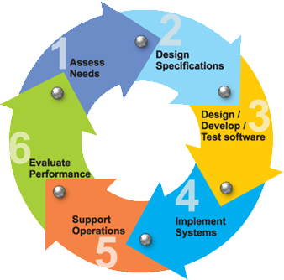

Slide 3
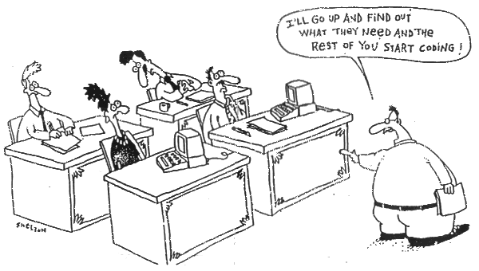
1. Assess Needs

Slide 4
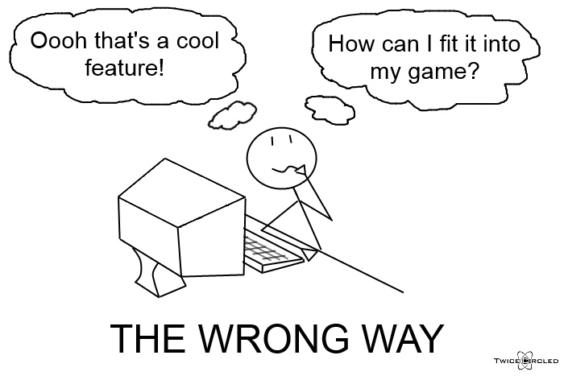
2. Design Specifications

Slide 5
Design Stage – The Right Way
Start with a pencil and paper, not the programming tools.
Draw each screen that your application will show.
Make a menu sketch to include all commands that your app will need.
Draw examples of reports that your app will print.
Review with your client and revise. Get you client’s signature for each page.

Slide 6
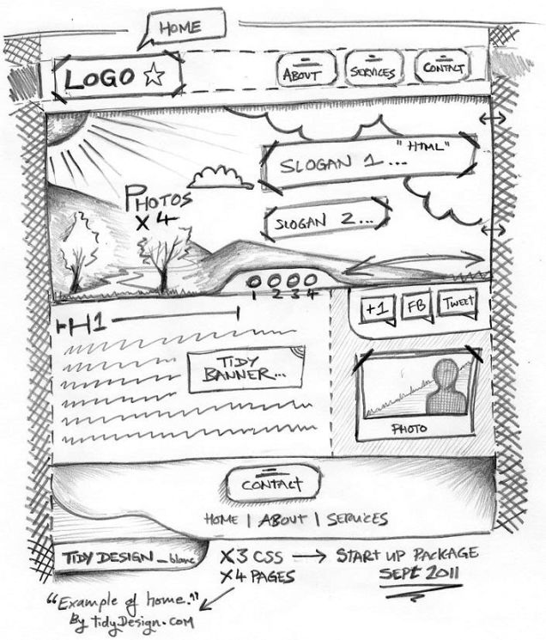
Design Stage – Draw what you think your app will look like

Slide 7
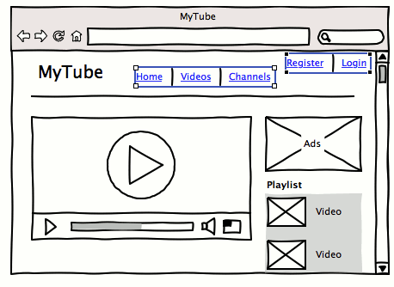
Design Stage – Draw each page in “Wireframes”

Slide 8
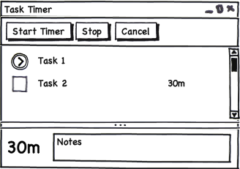
Design Stage – Include the controls you will see on the screen

Slide 9
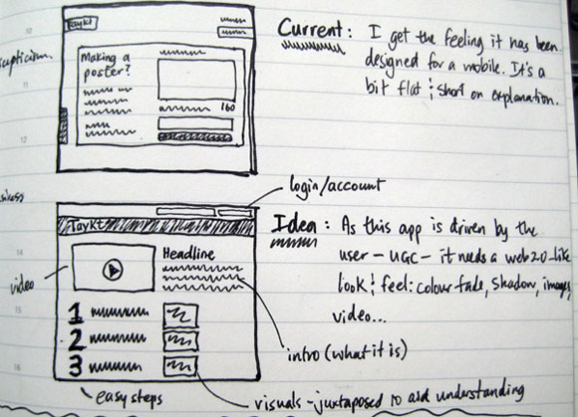
Design Stage – Make notes about what you are trying to accomplish.

Slide 10
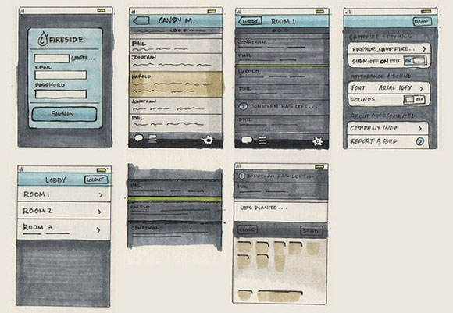
Design Stage – Sketch every screen in the application before you start coding.

Slide 11
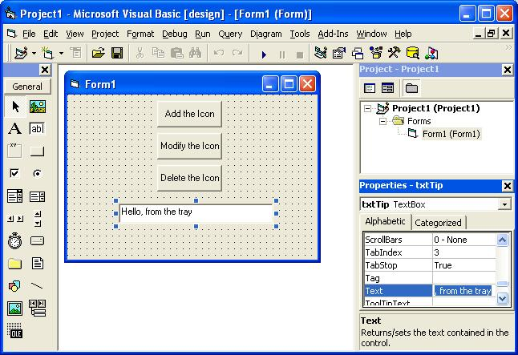
3. Development – User Interface

Slide 12
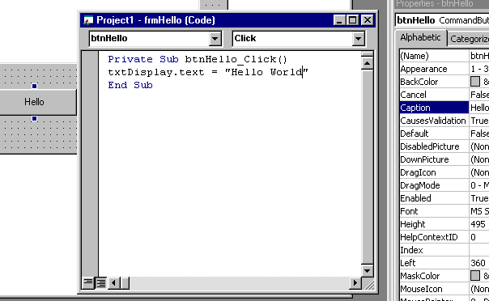
3. Development - Coding

Slide 13
3. Development - testing
Functional Testing
Usability Testing
Performance Testing
Security Testing
Compatibility Testing

Slide 14
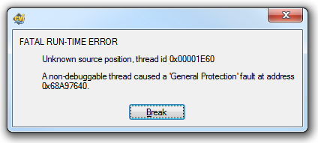
3. Development - testing
Functional Testing – does it do what you intended? Does it crash?

Slide 15

3. Development - testing
Usability Testing – try it with some users. Get their feedback. Watch what errors they make and where they get confused.

Slide 16
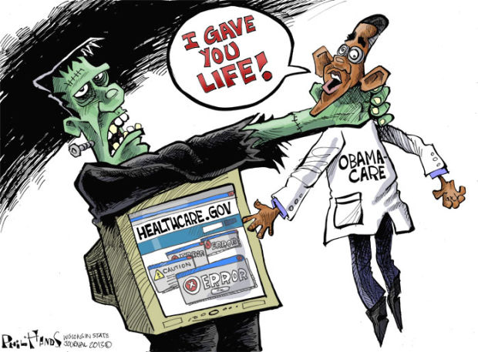
3. Development - testing
Performance Testing – how well does it work under a heavy load?

Slide 17
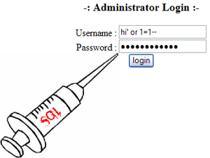
3. Development - testing
Security Testing – can you hack into it or make it crash? Try inputting garbage numbers or commands

Slide 18

3. Development - testing
Compatibility Testing – does it work on other computers? Browsers?

Slide 19
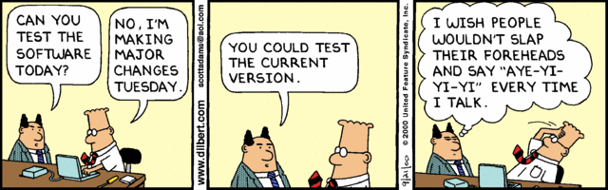

Slide 20
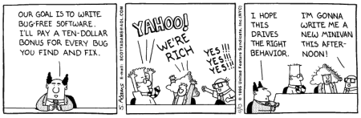

Slide 21

4. Implement

Slide 22
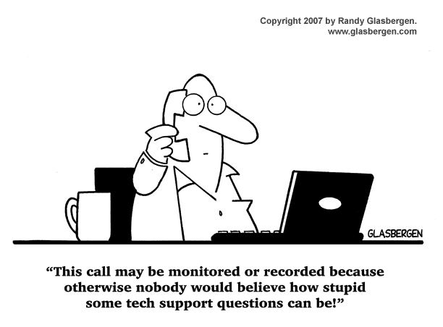
5. Support Operations (Maintenance Mode)

Slide 23

6. Evaluate Performance

Slide 24
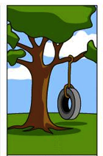
A customer needs something…

Slide 25
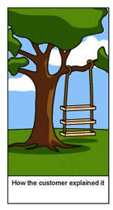
How the customer explained it

Slide 26
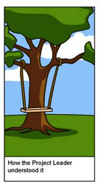
How the project leader understood it

Slide 27
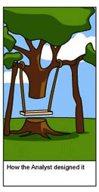
How the Analyst designed it

Slide 28
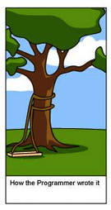
How the programmer wrote it

Slide 29
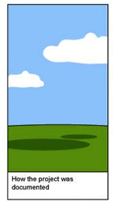
How the project was documented

Slide 30
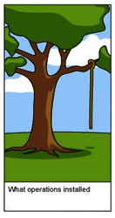
What was installed

Slide 31
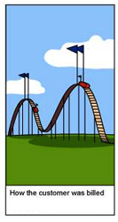
How the customer was billed

Slide 32
What the customer needed.

